Slide 1


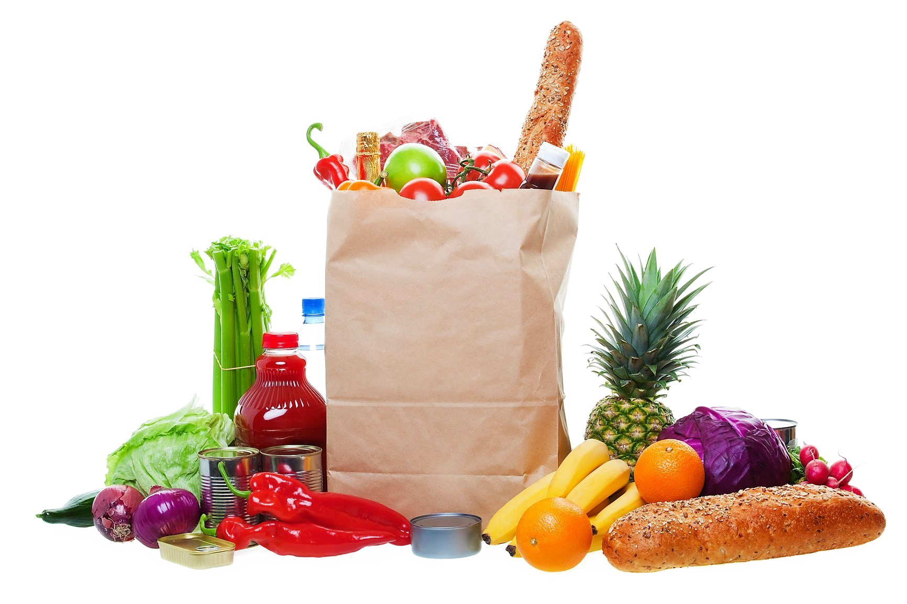
Grocery Store Inventory Management System

Slide 2
Introduction
The Grocery Store Management System automates daily store operations, ensuring smoother workflows and better efficiency.
It eliminates the need for manual record-keeping and reduces human errors.
The system manages product inventory, billing, and customer details in one integrated platform.This helps store owners maintain accurate and up-to-date records easily.
It streamlines the billing process by generating quick and accurate invoices for customers.This not only saves time but also improves customer satisfaction.
The system provides real-time insights into stock levels, sales trends, and supplier data.
The goal is to enhance overall productivity and operational transparency.

Slide 3
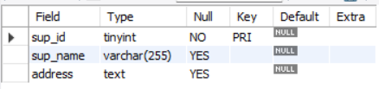
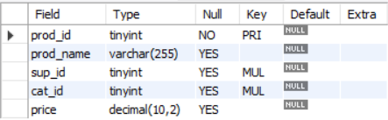
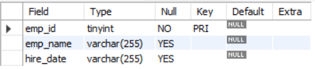
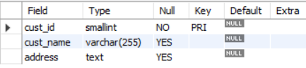
Tables
Suppliers Table
Products Table
Employees Table
Customers Table
.

Slide 4
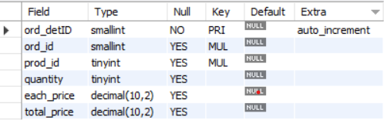
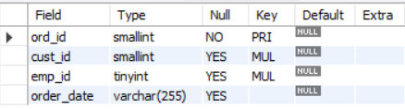
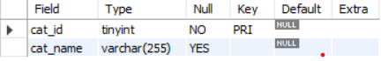
Order details Table
Orders Table
Categories Table
.

Slide 5
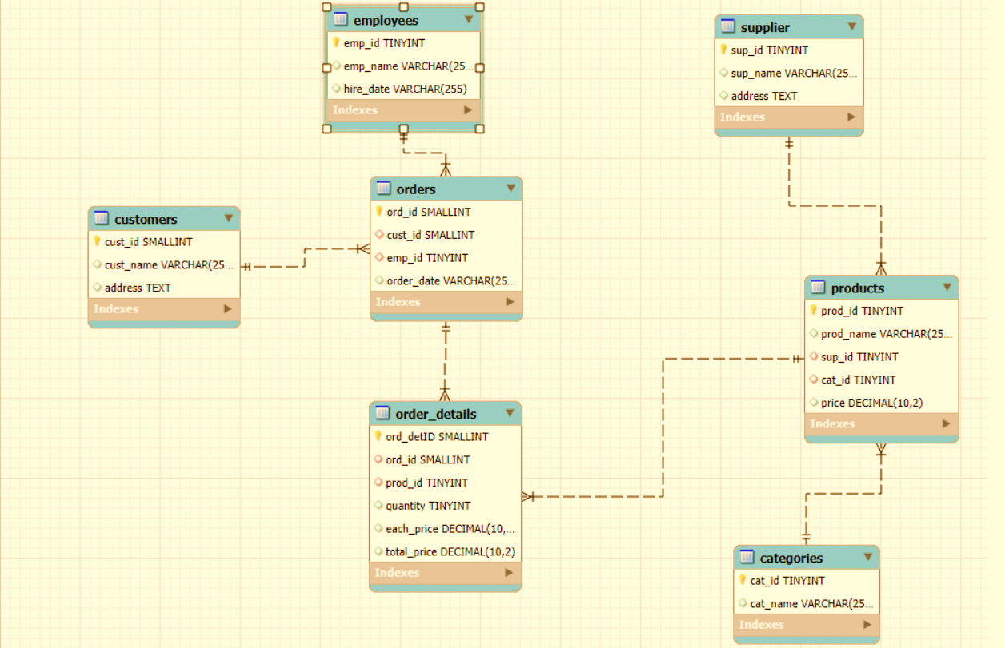
ER Diagram
.

Slide 6
In the dynamic environment of a retail grocery store, managing and analyzing large volumes of data related to products, suppliers, customers, and orders is crucial for efficient operations and informed decision-making. This project aims to design and implement a relational database system that captures essential store activities and enables users to retrieve and analyze data through SQL. The system will support complex queries to identify key business insights such as top-performing products, high-value customers, and revenue patterns, while reinforcing practical SQL skills including joins, aggregations, subqueries, and filtering.
Problem Statement

Slide 7
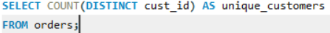
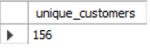
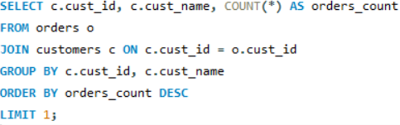
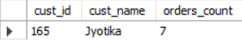
1.How many unique customers have placed orders?
output
2.Which customers have placed the highest number of orders?
output

Slide 8
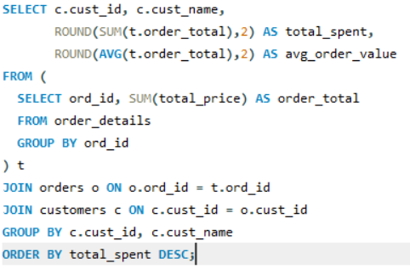
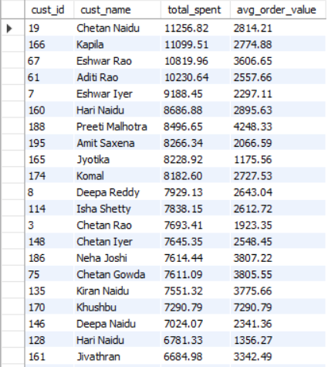
3.What is the total and average purchase value per customer?
output

Slide 9
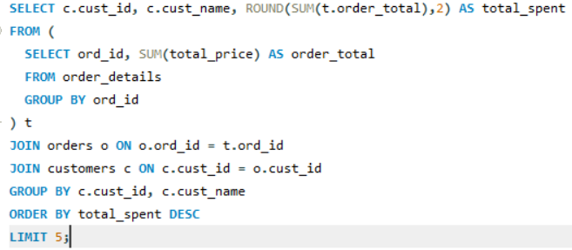
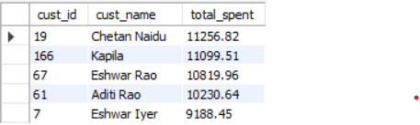
4.Who are the top 5 customers by total purchase amount?
output

Slide 10
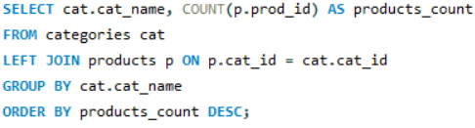
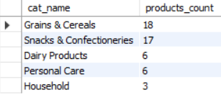
5.How many products exist in each category?
output

Slide 11
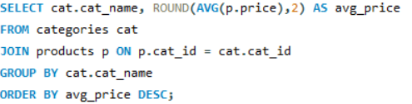
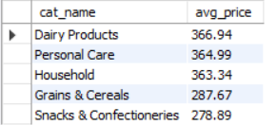
6.What is the average price of products by category?
output

Slide 12
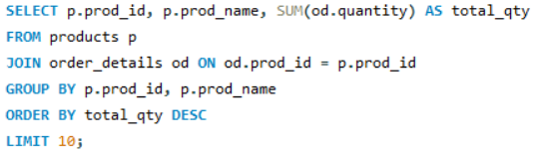
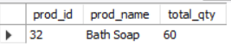
7.Which products have the highest total sales volume (by quantity)?
output

Slide 13
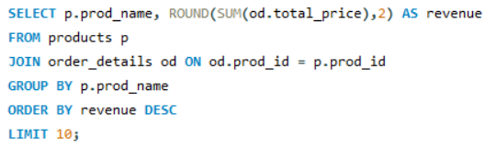
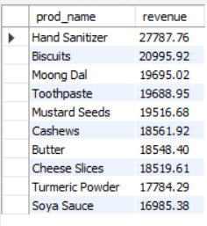
8.What is the total revenue generated by each product?
output

Slide 14
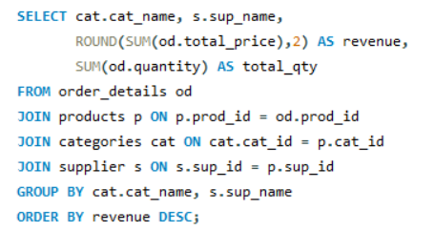
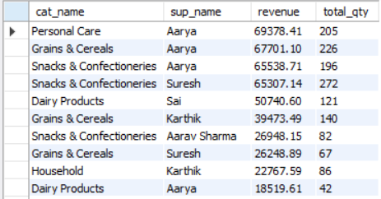
9.How do product sales vary by category and supplier?
0utput

Slide 15
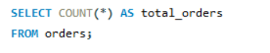
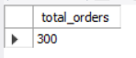
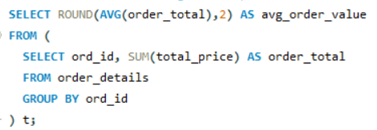
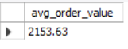
10.How many orders have been placed in total?
output
11.What is the average value per order?
output

Slide 16
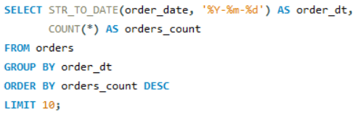
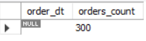
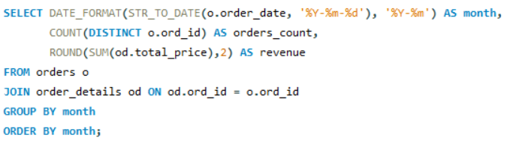
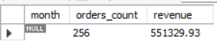
12.On which dates were the most orders placed?
output
13.What are the monthly trends in order volume and revenue?
output

Slide 17
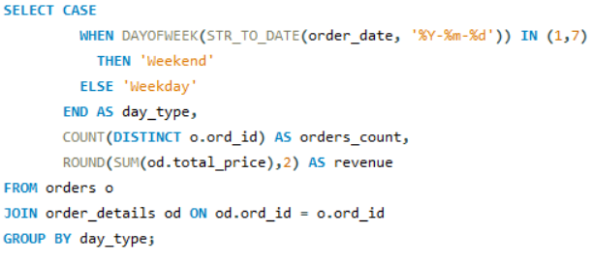
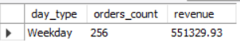
14.How do order patterns vary across weekdays and months?
output

Slide 18
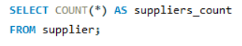
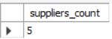
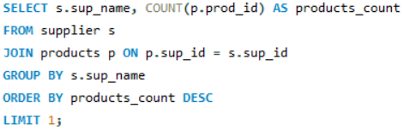
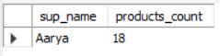
15.How many suppliers are there in the database?
output
16.Which supplier provides the most products?
output

Slide 19
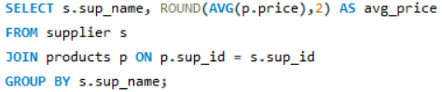
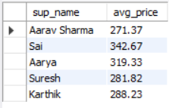
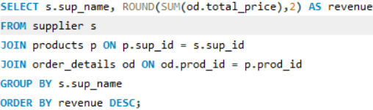
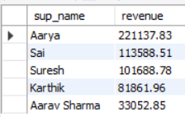
18.Which suppliers contribute the most to total product sales (by revenue)
17.What is the average price of products from each supplier?
output
output

Slide 20
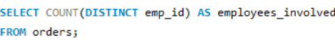
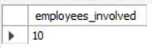
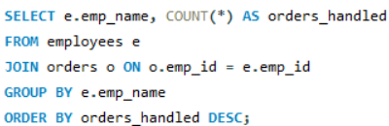
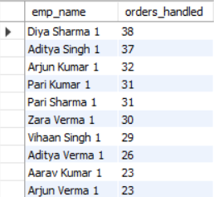
20.Which employees have handled the most orders?
19.How many employees have processed orders?
output
output

Slide 21
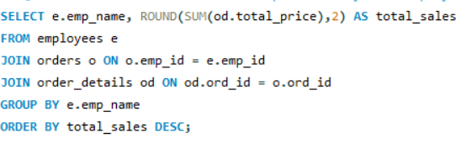

output
21.What is the total sales value processed by each employee?

Slide 22




output
22.What is the average order value handled per employee?
23.What is the relationship between quantity ordered and total rice?
output

Slide 23


24.What is the average quantity ordered per product?
output

Slide 24


0utput
25.How does the unit price vary across products and orders?

Slide 25

Team Members:
Bode Jagadish kumar
Tripurarm Rudra Reddy
Likhitapudi JoshiKanth

